Slide 1
WEB & UI Design
Design lifecycle?

Slide 2
What is User Centred Design?
Evaluation of a product at the end of its design/ development lifecycle is too late
User Centred Design (UCD) -
Focuses on information about the users and their requirements
The users are included as part of the planning, design, development, and testing of the product
Constant evaluation and feedback during the design/ development lifecycle
Advantages of UCD?

Slide 3
Principles of User Centred Design
The following are recommendations by Gould and Lewis (1985)
Early Focus on Users and Tasks
Who are the users?
Understand the users
Empirical Measurement
Focus on ease of learning and ease of use
Testing of prototypes with actual users
Iterative Design
Product designed, modified and tested repeatedly.
Allow for the complete overhaul and rethinking of design by early testing of conceptual models and design ideas.
Paper available for download at: http://info.umuc.edu/its/MSIT/msit650/fall02/pdf/paper6.pdf

Slide 4
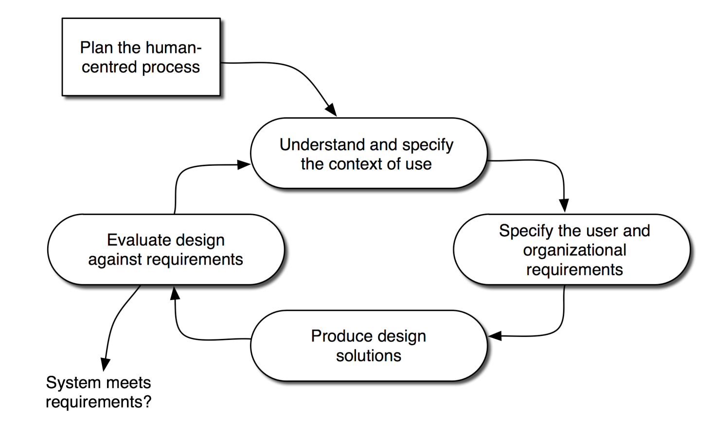
An International Standard
ISO 9241:210 Ergonomics of human-system interaction
Provides a standard framework for UCD activities
Concerned with ways in which both hardware and software components of interactive systems can enhance human–system interaction.
http://www.iso.org/iso/catalogue_detail.htm?csnumber=52075

Slide 5
A User Centred Design Methodology
Analysis
Identify needs and establish requirements for the user experience
Design
Produce (alternative) designs that meet those requirements
Prototype
Building interactive versions of the designs
Evaluate
Usability testing with actual users

Slide 6
Analysis – User Profile
Target Audience
Who are they?– Examples:
Current users
Prospective users
Ability/ Experience
Access to technology (hardware, broadband Internet, etc.)
Identify the competition (i.e. used by target audience)
Advantages
Strengths and Weaknesses
Opportunities for improvement
How to find out?
Survey
Questionnaire
Interview
Research competition

Slide 7
Analysis – Needs & Goals
How do users perform tasks?
Current methods/ applications, etc.
Any issues or problems
Suggested improvements
Create user Profiles
Needs and Goals of Application
Purpose
Objectives
Task analysis
Observe users
Identify and prioritise tasks/ subtasks
Document user requirements

Slide 8
Participatory Design
Participatory Design
Active User Collaboration
Brainstorming
Storyboarding
Workshops
Pencil and Paper Exercises

Slide 9
Design - Conceptual
Description of the user experience
Context: Content and Environment
Description of environment where user interacts with content.

Slide 10
Design – Flow and Navigation
Visual map of the application from top down.
Levels:
Level one: single page overview of the application
Level two: increases the level of detail adding essential decisions and branching.
Level three: further detail with all storyboard references, calculations, branching, information management and user control.
Levels depend on application complexity

Slide 11
Design - Storyboard
Storyboards were originally used in cartoon, film and TV production to take snapshots of each significant scene.
Outline, in pictorial form, the sequence of the application.
Very Quick design – On paper
Hand drawn: clarity, not artistic ability, important
Provides a visual representation of design, as well as details that programmers will need to implement it.
Test structure without content.
Maps to Flowchart

Slide 12
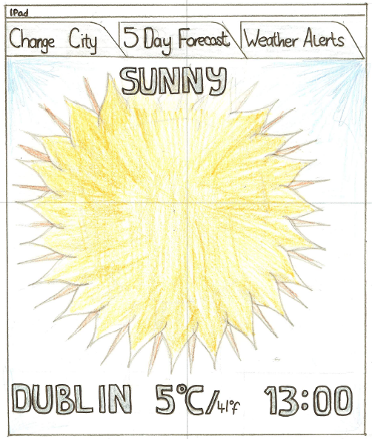
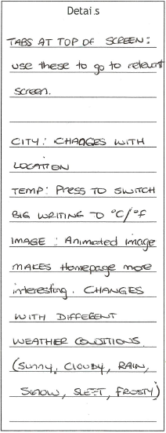
EXAMPLE – Storyboard for WEATHER SYSTEM FOR IPAD
User Interaction
Design Details
Font Style of text
Font Colour of text
Font size of text
Background Colour
Shape of controls

Slide 13
EXAMPLE – Storyboard for computer telephone
Computer Telephone
Help Screen
Computer Telephone
You can enter either the
Last Name:
Help->
person's name or their
Call by
Last Name: Greenberg
Establishing
First Name:
number. Then hit the
name->
First Name:
connection->
Phone:
place button to call them
Phone:
Place Call
Help
Return
Place Call
Help
Computer Telephone
Computer Telephone
Dialling....
Call
Connected
Call
Last Name: Greenberg
connected...
Last Name: Greenberg
completed...
First Name:
First Name:
Phone:
Cancel
Phone:
Hang up
Place Call
Help
Place Call
Help

Slide 14
Design - Interface
Clear design for an intuitive experience
Function of each control on every screen
Understandable structure and flow
Wide & Shallow Vs Narrow & Deep
Clear organization of information
Respect for human factors

Slide 15
Prototype
Perform usability evaluation as early as possible in the design cycle by building and evaluating prototypes.
Prototypes cut down on either the number of features, or the depth of functionality of features:
Vertical Prototype: in-depth functionality for a few selected features.
Horizontal Prototype: full interface features, but no underlying functionality.
Scenario: only features and functionality along a pre-specified scenario (task) or path through the interface. “Description of an individual user using specific computer facilities to achieve a specific outcome under specified circumstances along a certain time dimension.”

Slide 16
Evaluation & Testing I
Different from programming (debugging)
Why do evaluation?
To reflect user’s needs - not designer intentions
To rank against the competition
To conform to standards
To guide design
Formative vs. Summative
“When the cook tastes the soup, that’s formative; when the guests taste the soup, that’s summative.“ - Robert Stakes, Ph.D., a noted evaluator.
Design
Model
User’s
Model
Designer
User
Documentation
System
System
Image

Slide 17
Evaluation & Testing II
Laboratory studies
Sophisticated & expensive equipment
Lack of context
Heisenberg uncertainty principle
Field studies
Informal & open

Slide 18
Usability Testing
Usability testing
Ensure that the interface functions as expected
Recruit test subjects representative of user base
Create test scearios which require users to use various aspects of site functionality
Conduct test in comfortable environment
Observe, interview, or questionnaire
Provide clear instructions
E.g. to test navigation
Did it work as expected – could the tester complete the test
Document – yes, no, and reasons/ suggestions.
Allow user to perform their own tasks, e.g. how they would find the page.

Slide 19
Usability Testing
Usability testing
Questionnaire examples:
Satisfaction
Overall site
Navigation
Speed
Ease of use
to complete specific tasks
to find information
Use forms
Appropriate use and accuracy of titles, headings, link names
Use of icons and images: appropriate and easy to understand?
Accuracy and usefulness of content/ information
Would they:
return to the site
Recommend it to others
Suggest improvements

Slide 20
Iterate
Star Life Cycle (Hix and Hartson)
Implementation
Task analysis/
functional analysis
Prototyping
Evaluation
Requirements
specification
Conceptual design/
formal design

